Slide 1

Movies Data analysis
Presented by
P Krishna Chetana Priyanka

Slide 2
PROJECT STEPS
Business Requirement Understanding
Understanding of DATA
Data Connection if Required
Data Cleaning / Quality Check
Data Modelling
Data Processing
DAX Calculations
Dashboard Design
Charts Creation and Formatting
Finding Insights

Slide 3
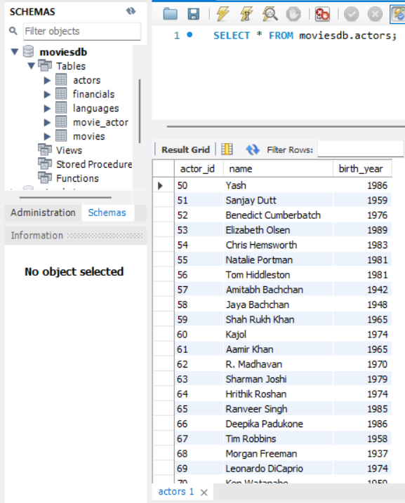
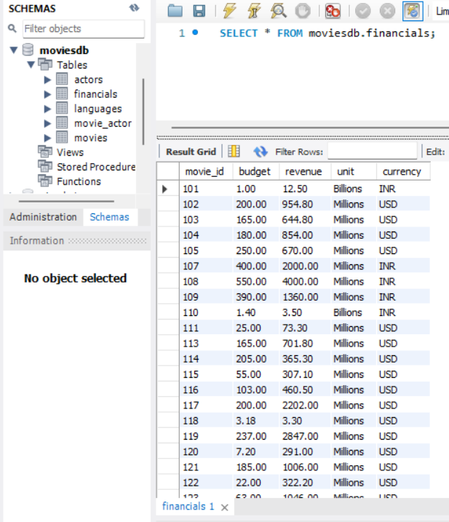
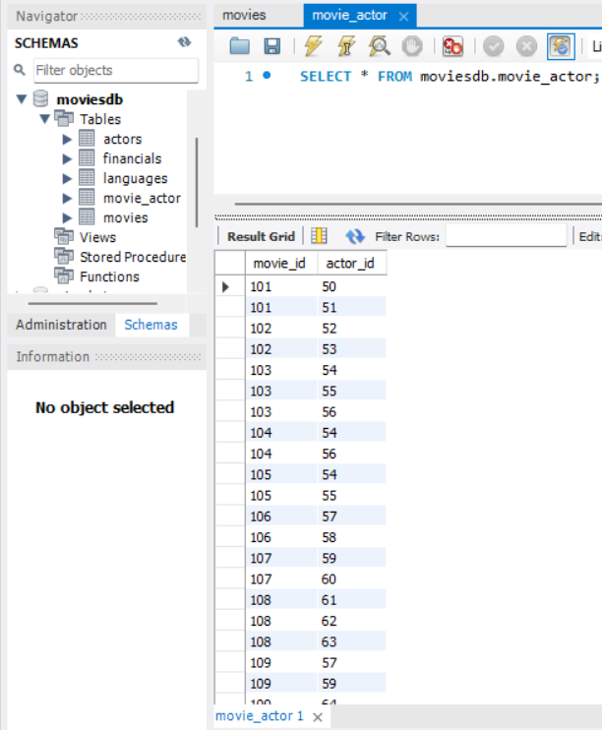
SQL DATABASE
Table: Actors
Table: Financials
Table: Movie Actor

Slide 4
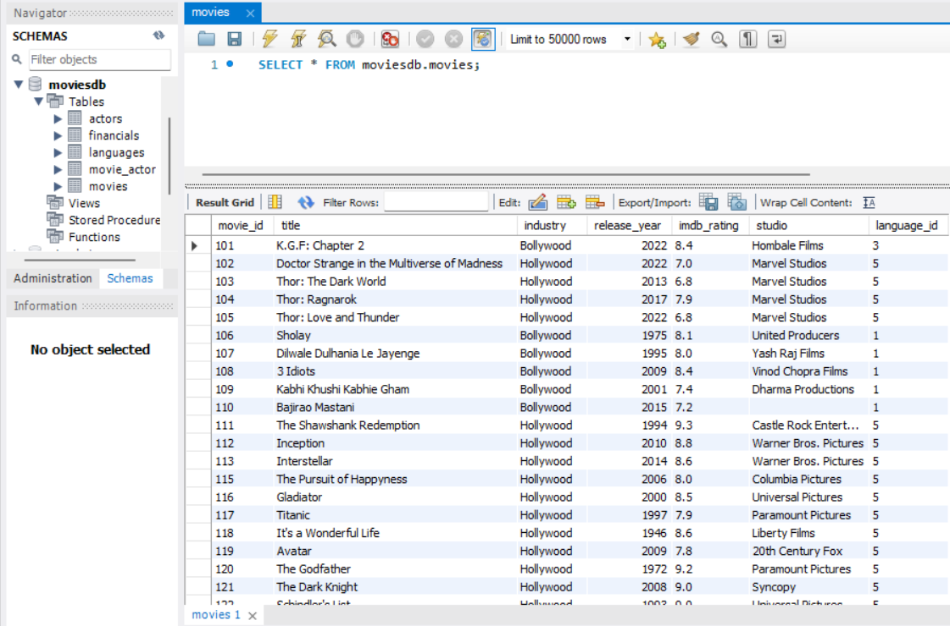
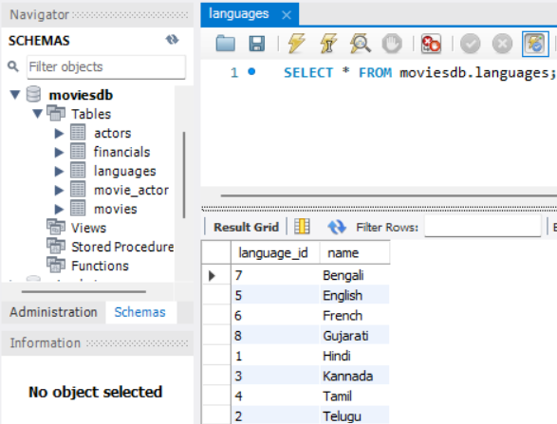
Table: Movies
Table: Languages

Slide 5
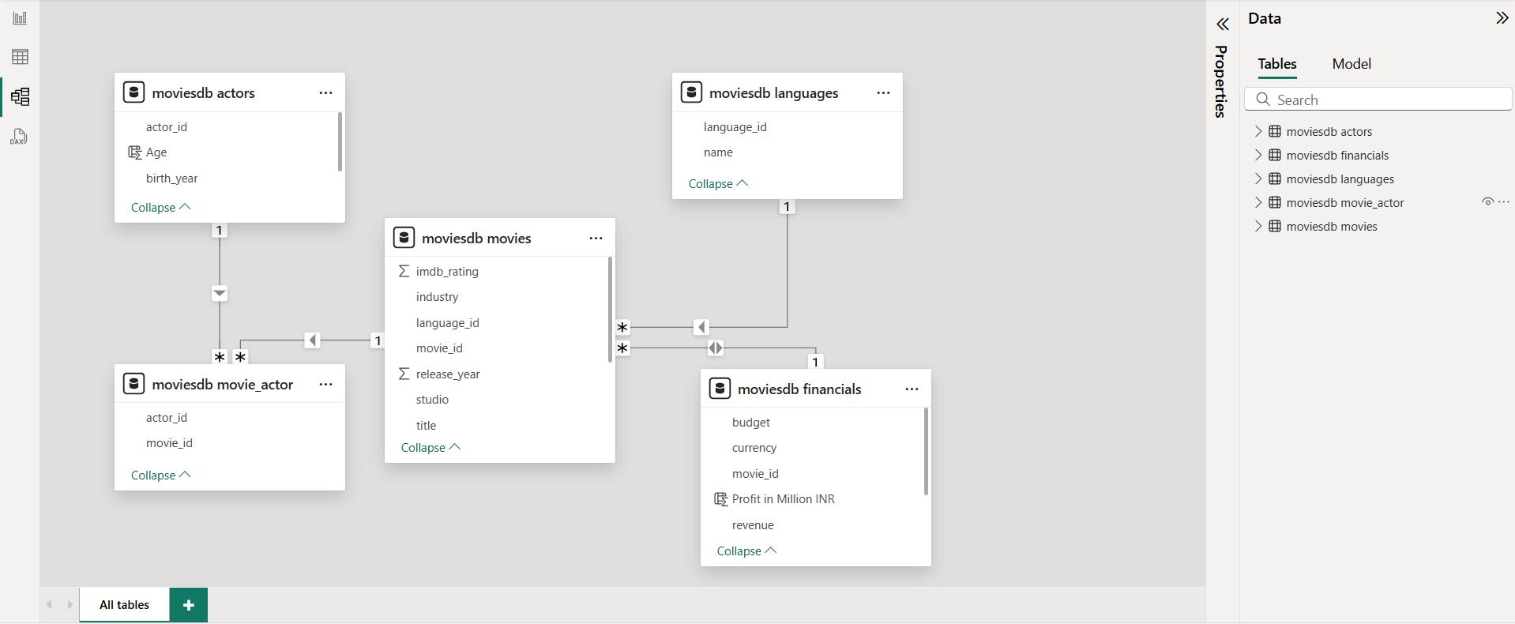
Data modelling

Slide 6





kpi’S
Total Movies: The total number of movies analyzed in the dataset
Total Industry: The number of different film industries included in the analysis.
Total Studios: The total number of movie studios represented in the data.
Average IMDb Rating: The average IMDb score of all movies in the dataset.
Total Revenue: The total revenue generated from all movies.

Slide 7
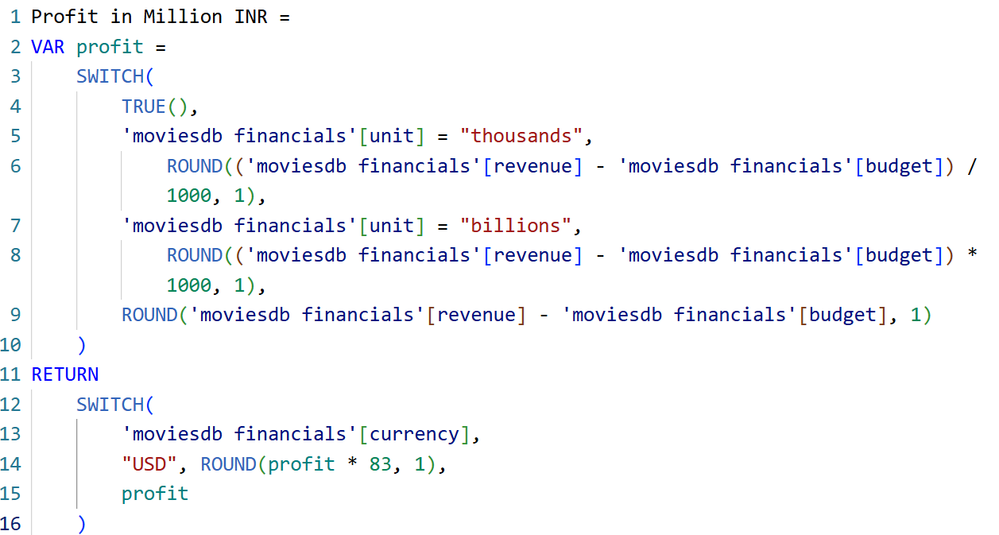
Dax Formulas

Slide 8
Charts
Total Movies by Language – Bar Chart
Total Movies by Currency – Column Chart
Total Movies by Industry – Pie Chart
Filter Panel - Slicers
Total Movies by Studio – Column Chart
Actor Details (Name, Birth Year, Age) - Table
Top Movies and Profit – Table

Slide 9
